Slide 1
Lecture 2: Knowledge Representation

Slide 2
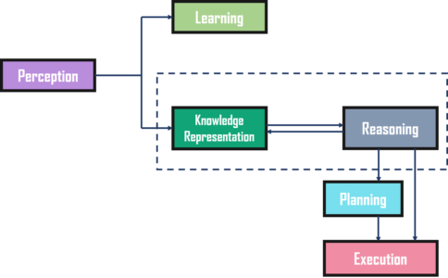
Knowledge Representation?

Slide 3
Knowledge Representation?
What?
The process of representing knowledge in a way that can be interpreted and used by machines
Knowledge representation involves transforming knowledge into a structured format that can be processed and manipulated by computer programs
Why is important?
Enables computers to reason, learn and make decisions based on knowledge
Helps in solving complex problems
Facilitates knowledge sharing and reuse

Slide 4
Types of Knowledge Representation?
Logic-based representation: uses formal logic to represent knowledge, e.g., propositional logic, predicate logic
Semantic networks: represent knowledge as nodes and links between them, e.g., concept maps
Frames and scripts: organize knowledge into hierarchical structures with attributes and values, e.g., object-oriented programming
Rule-based systems: represent knowledge as a set of rules or conditional statements, e.g., expert systems

Slide 5
Quiz Time

Slide 6
Logic Representation: Propositional
Uses formal logic to represent knowledge, e.g., propositional logic, predicate logic.
Propositional logic is a type of logic-based representation that uses statements or propositions to represent knowledge.
Each proposition is either true or false.
Example:
All men are mortal [p]
Socrates is a man [q]
Therefore, Socrates is mortal. [r]
All politicians are honest.
Sambit is a politician.
Sambit is honest.

Slide 7
Logic Representation: Predicate
Predicate logic is another type of logic-based representation that uses predicates or relations to represent knowledge.
Predicates can take one or more arguments, called terms, which can be constants, variables, or other predicates.
Predicate logic is more expressive than propositional logic and can be used to represent more complex knowledge.
Example: All dogs are mammals
For all x, if Dog(x), then Mammal(x)
where x is a variable that represents any dog,
Dog is a predicate that represents the concept of being a dog, and Mammal is a predicate that represents the concept of being a mammal.
This logical statement means that if something is a dog, then it is also a mammal.

Slide 8
Logic: Pros and Cons
Advantages:
Provides a formal and precise way to represent knowledge and reason about it.
Well-suited for tasks that involve deductive reasoning, such as automated theorem proving and decision-making.
Can be used to represent complex knowledge and relationships between concepts.
Disadvantages:
Can be limiting for tasks that involve uncertain or incomplete knowledge, as it assumes a binary true/false representation of knowledge.
Can be difficult and time-consuming to create logic-based representations, as they often require extensive knowledge engineering.
May not be suitable for tasks that require more flexible or nuanced reasoning, such as natural language understanding or common-sense reasoning.

Slide 9
Semantic networks
Semantic networks provide a graphical representation of knowledge, making it easier to understand and visualize.
Represents knowledge as nodes and links between them, e.g., concept maps.
Nodes represent concepts or objects, and links represent relationships between them.
They can represent complex relationships between concepts and objects.
Suppose we want to represent knowledge about different types of food and their relationships to each other.
We can use a semantic network to represent this knowledge.
For example, we can represent the concept of "pizza" as a node in the network, with links to other nodes representing related concepts such as "cheese", "tomato sauce", "pepperoni", etc.

Slide 10
Quiz Time

Slide 11
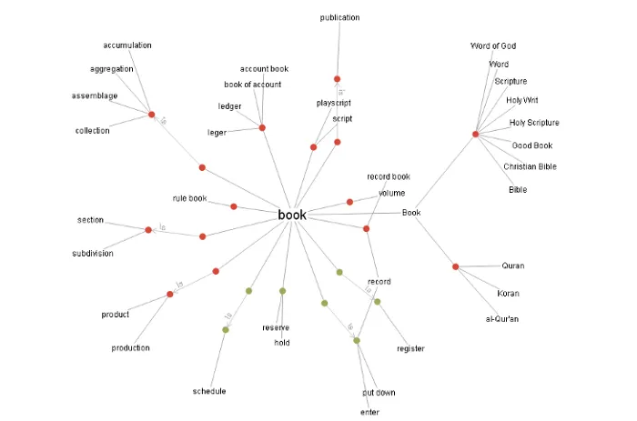
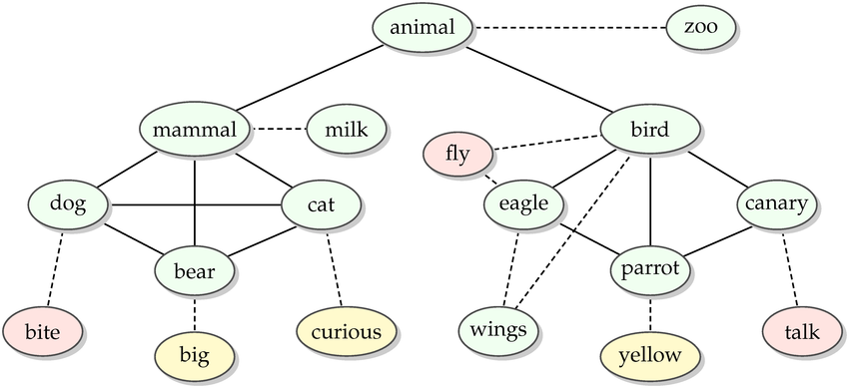
Semantic networks
They are useful in natural language processing, information retrieval, and knowledge-based systems.
Examples:
WordNet: a lexical database that organizes English words into synsets (sets of synonyms)
Cyc: a large-scale knowledge base that contains a vast amount of common sense knowledge
Notes:
Example:
Suppose a search engine needs to retrieve information about a particular topic. The search engine can use a semantic network such as WordNet to identify synonyms and related concepts to the search term, making the search more effective and efficient.

Slide 12
Semantic networks: Pros and Cons
Advantages:
Easy to understand and interpret: Graphical representation that is easy for humans to understand and interpret.
Useful for taxonomies and hierarchies
Support inheritance and default reasoning: Semantic networks can support inheritance, where properties of parent nodes are automatically inherited by child nodes.
Disadvantages:
Limited expressive power: Limited in their expressive power and may not be able to represent complex relationships or contexts.
Can be difficult to scale: As the number of concepts and relationships in a semantic network grows, it can become difficult to manage and maintain.
Can be ambiguous: The same concept may be represented by different nodes in different parts of the network, leading to ambiguity and inconsistency.
Notes:
Example:
Suppose a search engine needs to retrieve information about a particular topic. The search engine can use a semantic network such as WordNet to identify synonyms and related concepts to the search term, making the search more effective and efficient.

Slide 13
Frames and scripts
A type of knowledge representation technique that represents knowledge as hierarchical structures of frames or schemas.
Frames represent concepts or objects, while scripts represent sequences of events or actions.
Frames organize knowledge into a set of attributes or properties and their values, representing objects and concepts.
Frames and scripts are often used in natural language understanding and other AI applications.

Slide 14
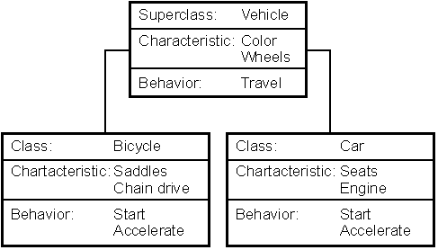
Example: Frames and scripts
Suppose we want to represent knowledge about different types of vehicles, such as cars, trucks, and buses.
We can use frames to represent this knowledge.
For example, we can create a frame for the concept of "car" that includes attributes such as "make", "model", "color", "year", and "number of doors".
Each instance of the frame would represent a specific car, with values for each attribute.
Object-oriented Programming
Notes:
Example:
Suppose a robot needs to navigate a complex environment. The robot can use a frame-based system to represent its knowledge of the environment, including objects, obstacles, and paths. The robot can then reason and make decisions

Slide 15
Frames and scripts: Pros and Cons
Advantages:
Used to represent complex and detailed knowledge, including both attributes and relationships between concepts.
Easily extended and modified, allowing for new knowledge to be added without major restructuring of the existing knowledge.
Used to represent knowledge in a more natural and intuitive way than other types of knowledge representation, particularly for tasks such as natural language understanding.
Disadvantages:
Computationally expensive to process and reason about, particularly for large or complex knowledge bases.
Prone to ambiguity and inconsistency, particularly when representing complex relationships between concepts or when multiple frames or scripts overlap or contradict each other.

Slide 16
Quiz Time

Slide 17
Rule-based systems
Rule-based systems represent knowledge as a set of rules that specify conditions and actions.
Rules are often represented as if-then statements or production rules.
Rule-based systems are often used in expert systems and other AI applications.
Example:
Expert System: A rule-based expert system for diagnosing medical conditions might have rules such as
"If the patient has a fever and a sore throat, then diagnose them with strep throat".
Another rule might be "If the patient has a rash and joint pain, then diagnose them with Lyme disease".

Slide 18
Example: Rule-based systems
Fraud detection systems: These systems use a set of rules to identify patterns of behavior that are consistent with fraud, such as unusual spending patterns or multiple purchases in different locations within a short period of time.
Traffic control systems: These systems use a set of rules to determine which traffic lights should be green, yellow, or red based on factors such as traffic volume and pedestrian crossings.
Manufacturing control systems: Some manufacturing plants use rule-based systems to control the production process. For example, a plant that produces steel may use a set of rules to adjust the temperature and pressure of the furnace based on the type of steel being produced and the desired quality of the final product.

Slide 19
Example: Pros and Cons
Advantages:
Can be written in a clear and concise way.
Can be used to model complex decision-making processes, such as in medical diagnosis or financial planning.
Can be used to encode expert knowledge, making it accessible to non-experts.
Disadvantages:
Can be difficult to scale to large knowledge bases, since the number of rules can become unwieldy.
Can be inflexible, since they rely on pre-defined rules and may not be able to adapt to changing situations.
Can suffer from uncertainty and ambiguity, since rules may be incomplete or contradictory.

Slide 20
Ontology
Ontologies are a way of representing knowledge by specifying a set of concepts and the relationships between them.
An ontology can be thought of as a structured vocabulary for a particular domain or subject area.
Used to integrate knowledge from multiple sources and represent it in a consistent and coherent way.
Allow for reasoning about the relationships between concepts, such as inferring new knowledge based on existing knowledge.
Can be used to represent knowledge in a wide range of domains, such as biology, medicine, finance, and more.
Examples:
Gene Ontology and FOAF Ontology
Typically represented using a formal language, such as the Web Ontology Language (OWL).

Slide 21
How to Choose?
Expressiveness: More expressive techniques are better suited for representing complex and abstract knowledge.
Ease of use: Techniques that are intuitive and easy to learn are preferred, especially for applications that involve a large number of knowledge sources.
Scalability: Techniques that can scale to large knowledge bases are preferred for applications that involve big data or knowledge-intensive tasks.
Maintainability: Techniques that are easy to update and maintain are preferred, especially for applications that require frequent updates or changes to the knowledge base.

Slide 22
Suggestion
Semantic networks are best suited for representing simple knowledge that can be easily visualized as a network.
Example: A map of the connections between cities.
Frames are best suited for representing complex objects that have many different properties and relationships.
Example: Description of a car that includes its make, model, year, color, and other attributes.
Rules are best suited for representing knowledge that involves decision-making or inference.
Example: Set of rules that determine whether a loan application should be approved or denied.
Ontologies are best suited for representing knowledge in complex domains that involve many different concepts and relationships.
Example: Gene Ontology, which represents knowledge about genes and their functions.
Notes:
Overall, the choice of knowledge representation technique depends on the nature of the knowledge being represented, as well as the requirements of the application and the domain.

Slide 23


